Slide 1



Data Science with R
PT GANESHA CIPTA INFORMATIKA

Slide 2
CLUSTER ANALYSIS
LOGISTIC REGRESSION
DECISION TREE

Slide 3
CLUSTER ANALYSIS
PENGANTAR CLUSTER ANALYSIS
HIERARCHICAL CLUSTERING
NON-HIERARCHICAL CLUSTERING

Slide 4
PENGANTAR CLUSTER ANALYSIS

Slide 5
Tipe Klasifikasi
Supervised
Segmen-nya telah diketahui
Tujuan analisis adalah menentukan kelompok dari individu tertentu berdasarkan karakteristik yang dia miliki, jika sifatnya mirip dengan sifat individu lain yang ada segmen tertentu maka dia dikategorikan ke segmen tersebut.
Analisis dilakukan dengan terlebih dahulu menentukan aturan (rules) yang digunakan untuk mengklasifikasikan individu
Aturan penentuan kelompok dapat berbasis pada model atau non-model
Sering disebut sebagai classification analysis
Unsupervised
Segmen yang ada belum diketahui
Analisis lebih bersifat eksploratif dan deskriptif
Output berupa pengelompokan individu yang ada dalam data dengan ketentuan bahwa individu yang karakteristiknya mirip akan dikelompokkan pada grup yang sama
Sering disebut sebagai cluster analysis

Slide 6
Apa itu Cluster Analysis?
Menemukan grup dari objek/individu sedemikian rupa sehingga objek dalam grup yang sama memiliki karakteristik yang mirip sedangkan objek dari grup yang berbeda memiliki karakteristik yang kontras/berbeda.
Jarak Inter-cluster maksimum
Jarak Intra-cluster minimum

Slide 7
Mengapa Perlu Cluster?
Clustering: memberikan kumpulan kelompok data objek kelompok sehingga
Dalam satu cluster satu sama lain mirip
Objek antar cluster tidak mirip
Hasil Clustering digunakan sebagai:
stand-alone tool untuk mendapatkan pengetahuan yang dalam sebaran data
Visualisasi kelompok dapat mengungkap informasi penting
preprocessing step untuk algoritma lain
Pengindeksan atau kompresi yang efisien sering kali bergantung pada clustering

Slide 8
Aplikasi Potensial
Segmentasi Pasar
Pasar dibagi menjadi group yang lebih kecil yang memiliki kebutuhan yang homogen
Identifikasi Outlier

Slide 9
Objectives of cluster analysis
Address the heterogenity in the data
Divide the data into more homogeneous groups
Find the natural modality of data
Determine whether the data contains naturally occurring, homogeneous subsets

Slide 10
Teknik Clustering
Satu variabel
Dua variabel
> 2 variabel

Slide 11
Ilustrasi: Aplikasi pada data pemegang kartu ATM
Data: transaksi.csv
Setiap pemegang kartu ATM dari suatu bank memperoleh fasilitas berikut
Melakukan transaksi tunai di mesin ATM
Melakukan transaksi non-tunai di mesin ATM
Melakukan transaksi melalui layanan internet banking
Melakukan debit untuk keperluan belanja di berbagai merchants
Tersedia data sampel 8000 customer dari bank tersebut yang berisi informasi mengenai
Frekuensi empat jenis transaksi di atas dalam satu bulan terakhir
Beberapa informasi dasar mengenai nasabah (usia, jenis kelamin, rata-rata saldo harian)

Slide 12
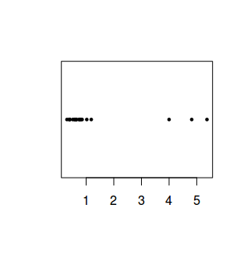
Teknik Clustering 1 Variabel
Visualisasi: dotplot
setwd("Documents/Mandiri/modul9")
nasabah <- read.csv('transaksi.csv')
nasabah20 <- nasabah [1:20,]
stripchart(nasabah20$saldoharian,"stack",pch=19,cex=0.5)

Slide 13
Teknik Clustering 1 Variabel
Metode:
Equal intervals,
Mean-standard deviation,
Quantiles,
Maximum breaks and
Natural breaks (jenks)
(harus menginstall package “classInt”)
library(classInt)
partisi1 <- classIntervals(nasabah20$saldoharian)
partisi2 <- classIntervals(nasabah20$saldoharian,n=4,style="jenks")
nasabah20$cl1<-findCols(partisi1)
nasabah20$cl2<-findCols(partisi2)

Slide 14
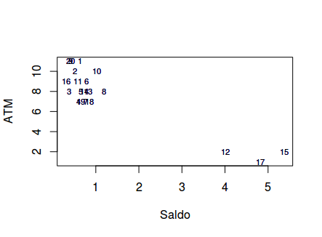
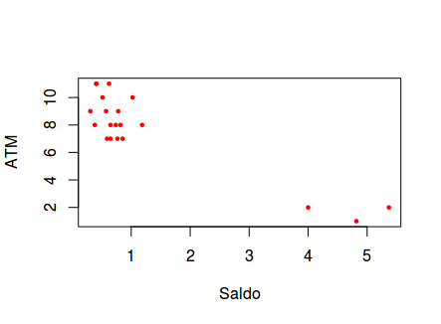
Teknik Clustering 2 Variabel
Dilakukan secara visual: plot
plot(nasabah20$saldoharian,nasabah20$tunaiATM,pch=19,cex=0.5,ylab="ATM",xlab=“Saldo”,col=2)
plot(nasabah20$saldoharian,nasabah20$tunaiATM,type="n",ylab="ATM",xlab="Saldo")
text(nasabah20$saldoharian,nasabah20$tunaiATM,nasabah20$nasabah,cex=0.7)

Slide 15
Teknik Clustering k variabel
Untuk k>2, metode visualisasi sulit digunakan → transformasi (seperti PCA)
Menggunakan ukuran kuantitatif untuk menyatakan kedekatan (kemiripan) antar pengamatan: menggunakan konsep jarak:
d(a, b) ≥ 0
d(a, a) = 0
d(a, b) = d(b, a)
d(a, b) meningkat berarti kedua objek a dan b semakin tidak mirip
d(a, c) ≤ d(a, b) + d(b, c)
Semua peubah berupa bersifat numerik (kontinu)

Slide 16
Cluster analysis
Teknik Clustering k variabel
 | X1 | X2 | X3 | X3
Obs1 Obs2 Obs3 Obs4 Obs5 Obs6 Obs7 Obs8 Obs9 Obs10 | 5 3 2 5 . . . . . . | 2 3 4 3 . . . . . . | 1 4 3 2 . . . . . . | 3 2 5 4 . . . . . .
Cluster 1
Cluster 2
Cluster 3

Slide 17
Konsep Jarak / Distance
Jarak / distance merupakan konsep inti dari proses cluster analysis.
Jarak sering juga disejajarkan dengan istilah dissimilarity
Andaikan terdapat dua individu/objek yaitu A dan B, jarak antara keduanya dinotasikan d(A, B), maka sifat dari jarak adalah:
d(A,B) = d(B,A) ≥ 0
d(A,A) = d(B,B) = 0
Jika ada individu lain C maka d(A,B) ≤ d(A,C) + d(C,B)
Terdapat bermacam-macam formula/definisi perhitungan jarak:
Euclidean, Weighted Euclidean, Mahalanobis, City block, …
Jaccard, Hamming, …

Slide 18
Struktur Data
attributes/dimensions
data matrix
Distance matrix
tuples/objects
objects
objects

Slide 19
Euclidean Distance
Dengan p adalah banyaknya dimensi/ atribut/ variabel dan a_{k} dan b_{k} adalah nilai dari objek A dan B untuk variabel ke-k.
Ilustrasi
Nama | Tinggi Badan | Berat Badan | Umur
Ani | 160 | 80 | 36
Beni | 180 | 70 | 40
Carla | 180 | 60 | 45

Slide 20
Matriks Jarak
Ilustrasi
Nama | Tinggi Badan | Berat Badan | Umur
Ani | 160 | 80 | 36
Beni | 180 | 70 | 40
Carla | 180 | 60 | 45
Nama | Ani | Beni | Carla
Ani | 0 | 22.72 | 29.68
Beni | 22.72 | 0 | 11.18
Carla | 29.68 | 11.18 | 0

Slide 21
Minkowski Distance
Formula
Dengan r adalah sebuah parameter, p adalah banyanya dimensi (atribut), a_{k} dan b_{k} masing-masing adalah nilai atribut ke k dari objek A dan B.
Jika r = 1 → City Block (Manhattan, taxicab, L₁ norm) distance.
Jika r = 2. Euclidean distance
Minkowski Distance dapat dipandang sebagai bentuk umum dari Euclidean Distance

Slide 22
Similarity Between Binary Vectors
Pada situasi tertentu, setiap objek hanya dicirikan oleh atribut yang bersifat biner (hanya bernilai 0 atau 1)
Proses mendapatkan jarak dapat dilakukan dengan menghitung beberapa nilai berikut
M₀₁ = banyaknya atribut dimana A bernilai 0 dan B bernilai 1
M₁₀ = banyaknya atribut dimana A bernilai 1 dan B bernilai 0
M₀₀ = banyaknya atribut dimana A bernilai 0 dan B bernilai 0
M₁₁ = banyaknya atribut dimana A bernilai 1 dan B bernilai 1
Simple Matching and Jaccard Distance/Coefficients
SMC = number of matches / number of attributes
= (M₁₁ + M₀₀) / (M₀₁ + M₁₀ + M₁₁ + M₀₀)
J = number of value-1-to-value-1 matches / number of not-both-zero attributes values
= (M₁₁) / (M₀₁ + M₁₀ + M₁₁)

Slide 23
SMC versus Jaccard: Example
p = 1 0 0 0 0 0 0 0 0 0
q = 0 0 0 0 0 0 1 0 0 1
M₀₁ = 2
M₁₀ = 1
M₀₀ = 7
M₁₁ = 0
SMC = (M₁₁ + M₀₀)/(M₀₁ + M₁₀ + M₁₁ + M₀₀) = (0+7) / (2+1+0+7) = 0.7
J = (M₁₁) / (M₀₁ + M₁₀ + M₁₁) = 0 / (2 + 1 + 0) = 0

Slide 24
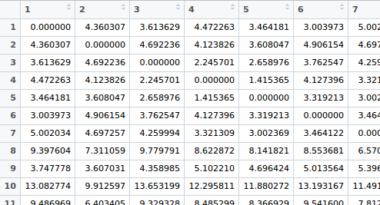
R session: euclidean distance
jarak1 <- dist(nasabah20[,-1])
as.matrix(jarak1)
jarak2 <- dist(nasabah20[,-1],method="manhattan")
as.matrix(jarak2)
Method: "euclidean", "maximum",
"manhattan", "canberra", "binary“
"minkowski"

Slide 25
Pengaruh satuan pengukuran variabel
Nama | Tinggi Badan(cm) | Berat Badan | Umur
Ani | 160 | 80 | 36
Beni | 180 | 70 | 40
Carla | 180 | 60 | 45
Nama | Tinggi Badan (m) | Berat Badan | Umur
Ani | 1.60 | 80 | 36
Beni | 1.80 | 70 | 40
Carla | 1.80 | 60 | 45
Nama | Ani | Beni | Carla
Ani | 0 | 22.72 | 29.68
Beni | 22.72 | 0 | 11.18
Carla | 29.68 | 11.18 | 0
Nama | Ani | Beni | Carla
Ani | 0 | 10.72 | 21.93
Beni | 10.72 | 0 | 11.18
Carla | 21.93 | 11.18 | 0
Semula, BENI lebih mirip CARLA…. jika menggunakan satuan yang baru (nilai datanya tetap) BENI lebih mirip ANI

Slide 26
Pengaruh satuan pengukuran variabel
Perhatikan bahwa ketika tinggi badan dalam satuan meter, nilai-nilai datanya menjadi lebih kecil dibandingkan variabel lain.
Variabel seperti ini menjadi “tidak penting” dalam penentuan jarak, dan seolah tersisihkan untuk menentukan kedekatan antar objek.
Untuk menghindari kejadian semacam ini, diusulkan untuk menggunakan data yang terbakukan (standardized) dan bukan data asli.
Data yang terbakukan menyebabkan semua variabel memiliki keragaman yang sama sehingga akan dianggap memiliki kepentingan yang seimbang dalam menentukan besar kecilnya jarak antar objek.

Slide 27
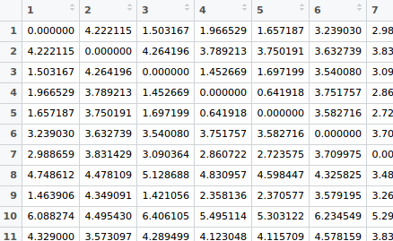
R session: euclidean distance
jarak1 <- dist(scale(nasabah20[,-1]))
as.matrix(jarak1)
jarak2 <- dist(scale(nasabah20[,-1]),method="manhattan")
as.matrix(jarak2)

Slide 28
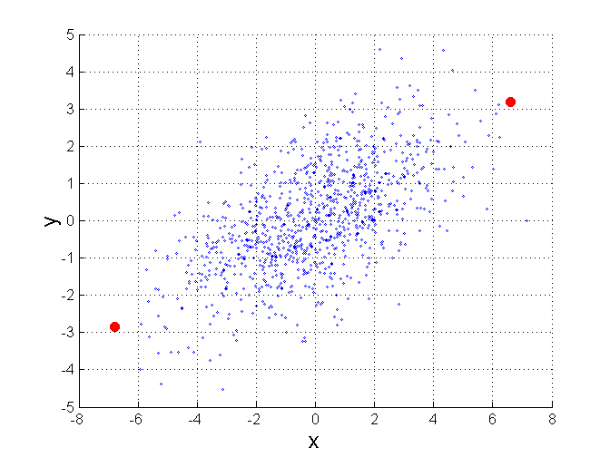
Mahalanobis Distance
B
Σ adalah matriks kovarian dari data X.
Jika antar variabel pada data X memiliki korelasi 0, maka matriks kovarian akan berupa matriks identitas dan jarak mahalanobis akan sama dengan jarak euclid.
Useful for detecting outliers.
A

Slide 29
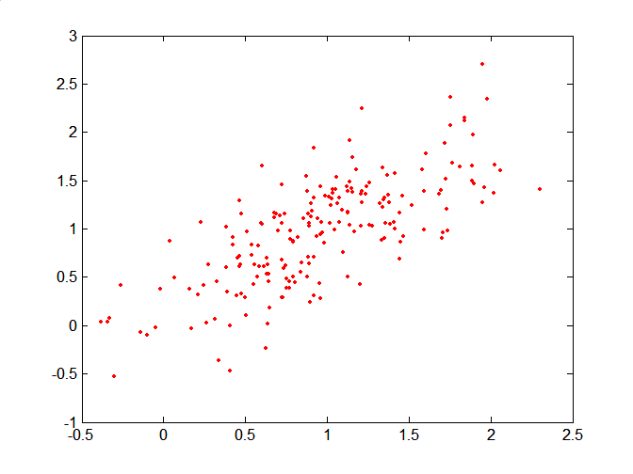
Mahalanobis Distance
Covariance Matrix:
C
A: (0.5, 0.5)
B: (0, 1)
C: (1.5, 1.5)
Mahal(A,B) = 5
Mahal(A,C) = 4
B
A

Slide 30
HIERARCHICAL CLUSTERING

Slide 31
Clustering procedures
Hierarchical procedures
Agglomerative (start from n clusters to get to 1 cluster)
Divisive (start from 1 cluster to get to n clusters)
Non hierarchical procedures
K-means clustering

Slide 32
Hierarchical clustering
Agglomerative:
Each of the n observations constitutes a separate cluster
The two clusters that are more similar according to same distance rule are aggregated, so that in step 1 there are n-1 clusters
In the second step another cluster is formed (n-2 clusters), by nesting the two clusters that are more similar, and so on
There is a merging in each step until all observations end up in a single cluster in the final step.
Divisive
All observations are initially assumed to belong to a single cluster
The most dissimilar observation is extracted to form a separate cluster
In step 1 there will be 2 clusters, in the second step three clusters and so on, until the final step will produce as many clusters as the number of observations.
The number of clusters determines the stopping rule for the algorithms

Slide 33
Hierarchical Agglomerative Clustering
Start with the points as individual clusters
At each step, merge the closest pair of clusters until only one cluster (or k clusters) left
Key operation is the computation of the proximity of two clusters
Different approaches to defining the distance between clusters distinguish the different algorithms
Use single linkage, complete linkage, average linkage, Ward’s method, etc

Slide 34
Agglomerative Clustering Algorithm
Basic algorithm is :
Compute the proximity matrix
Let each data point be a cluster
Repeat
Merge the two closest clusters
Update the proximity matrix
Until only a single cluster remains

Slide 35
Small artificial example
1
0,42
3
2
6
4
5
0,58
Note: 6 points yield
15 possible pairwise
distances - [n*(n-1)]/2

Slide 36
Small artificial example
1
0,42
3
2
6
4
5
0,58

Slide 37
Small artificial example
1
0,42
3
2
6
4
5
0,58

Slide 38
Small artificial example
1
0,68
0,42
3
2
6
0,92
4
5
0,58

Slide 39
Small artificial example
1
0,68
0,42
3
2
6
0,92
4
5
0,58

Slide 40
Small artificial example
1
0,68
0,42
3
2
6
0,92
4
5
0,58

Slide 41
Small artificial example
1
0,68
0,42
3
2
6
0,92
4
5
0,58

Slide 42
Dendrogram
OBS 1
*
OBS 2
*
Step 0:
Each observation
is treated as a
separate cluster
OBS 3
*
OBS 4
*
OBS 5
*
OBS 6
*
Distance Measure
0,2 0,4 0,6 0,8 1,0

Slide 43
Dendrogram (Continued)
OBS 1
*
Cluster 1
OBS 2
*
Step 1:
Two observations
with smallest
pairwise distances
are clustered
OBS 3
*
OBS 4
*
OBS 5
*
OBS 6
*
0,2 0,4 0,6 0,8 1,0

Slide 44
Dendrogram (Continued)
OBS 1
*
Cluster 1
OBS 2
*
Step 2:
Two other observations
with smallest distances
amongst remaining points/clusters
are clustered
OBS 3
*
OBS 4
*
OBS 5
*
Cluster 2
OBS 6
*
0,2 0,4 0,6 0,8 1,0

Slide 45
Dendrogram (Continued)
OBS 1
*
Cluster 1
OBS 2
*
OBS 3
*
Step 3:
Observation 3 joins
with cluster 1
OBS 4
*
OBS 5
*
Cluster 2
OBS 6
*
0,2 0,4 0,6 0,8 1,0

Slide 46
Dendrogram (Continued)
OBS 1
*
“Supercluster”
OBS 2
*
OBS 3
*
OBS 4
*
Step 4:
Cluster 1 and 2 - from
Step 3 joint into a
“Supercluster”
OBS 5
*
OBS 6
*
0,2 0,4 0,6 0,8 1,0
A single observation
remains unclustered (Outlier)

Slide 47
Bagaimana Menggabungkan Cluster?
Pautan Tunggal (Single Linkage, Nearest Neighbor)
Pautan Lengkap (Complete Linkage, Farthest Neighbor)
Pautan Centroid (Centroid Linkage)
Pautan Median (Median Linkage)
Pautan Rataan (Average Linkage)

Slide 48
Ilustrasi Linkage: jarak antar grup individu
A
B
*
*
10,5
7,0
C
*
8,5
D
*
Berapa jarak C ke group {AB} dan ke group{DE}?
9,5
E
*

Slide 49
Single linkage
A
B
*
*
7,0
C
*
8,5
D
*
Jarak C ke group adalah jarak ke titik terdekat
Complete linkage dikenal juga sebagai nearest neighbor
E
*

Slide 50
Complete linkage
A
B
*
*
10,5
C
*
D
*
Jarak C ke group adalah jarak ke titik terjauh
Complete linkage dikenal juga sebagai furthest neighbor
9,5
E
*

Slide 51
Centroid linkage
A
B
*
*
8,5
C
*
D
*
9,0
Jarak C ke group adalah jarak ke centroid group. Centroid tidak lain adalah titik dengan koordinat yang merupakan rata-rata koordinat anggotanya.
E
*

Slide 52
Average linkage
8.75
A
B
*
*
10,5
7,0
C
*
8,5
D
*
9.0
Jarak C ke group adalah rata-rata jarak ke masing-masing anggotanya group.
9,5
E
*

Slide 53
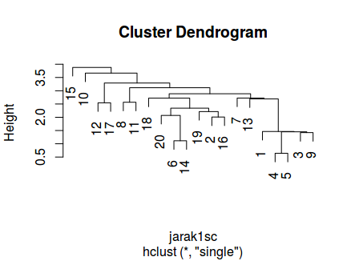
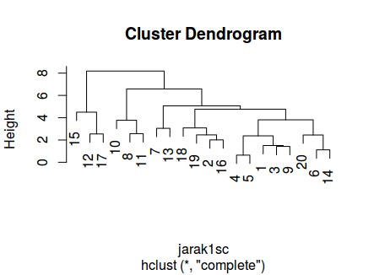
R Session:
clustsingle <- hclust(jarak1, method="single")
plot(clustsingle)
clustcomp <- hclust(jarak1, method="complete")
plot(clustcomp)

Slide 54
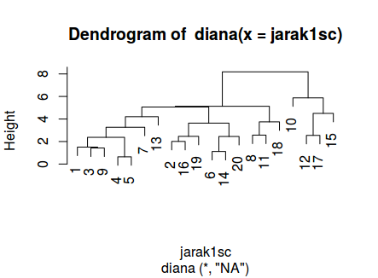
R Session:
library(cluster)
pltree(diana(jarak1))
Package cluster memuat
lebih banyak pilihan untuk
melakukan cluster analysis

Slide 55
NON-HIERARCHICAL CLUSTERING K-Means Cluster

Slide 56
The K-Means Clustering Method
Given k, the k-means algorithm is implemented in four steps:
Partition objects into k nonempty subsets
Compute seed points as the centroids of the clusters of the current partitioning (the centroid is the center, i.e., mean point, of the cluster)
Assign each object to the cluster with the nearest seed point
Go back to Step 2, stop when the assignment does not change

Slide 57
An Example of K-Means Clustering
K=2
Arbitrarily partition objects into k groups
Update the cluster centroids
The initial data set
Loop if needed
Reassign objects
Partition objects into k nonempty subsets
Repeat
Compute centroid (i.e., mean point) for each partition
Assign each object to the cluster of its nearest centroid
Until no change
Update the cluster centroids

Slide 58
Comments on the K-Means Method
Strength: Efficient: O(tkn), where n is # objects, k is # clusters, and t is # iterations. Normally, k, t << n.
Comparing: PAM: O(k(n-k)² ), CLARA: O(ks² + k(n-k))
Comment: Often terminates at a local optimal.
Weakness
Applicable only to objects in a continuous n-dimensional space
Using the k-modes method for categorical data
In comparison, k-medoids can be applied to a wide range of data
Need to specify k, the number of clusters, in advance (there are ways to automatically determine the best k (see Hastie et al., 2009)
Sensitive to noisy data and outliers
Not suitable to discover clusters with non-convex shapes

Slide 59
Variations of the K-Means Method
Most of the variants of the k-means which differ in
Selection of the initial k means
Dissimilarity calculations
Strategies to calculate cluster means
Handling categorical data: k-modes
Replacing means of clusters with modes
Using new dissimilarity measures to deal with categorical objects
Using a frequency-based method to update modes of clusters
A mixture of categorical and numerical data: k-prototype method

Slide 60
What Is the Problem of the K-Means Method?
The k-means algorithm is sensitive to outliers !
Since an object with an extremely large value may substantially distort the distribution of the data
K-Medoids: Instead of taking the mean value of the object in a cluster as a reference point, medoids can be used, which is the most centrally located object in a cluster
10
10
9
9
8
8
7
7
6
6
5
5
4
4
3
3
2
2
1
1
0
0
1
2
3
4
5
6
7
8
9
10
0
0
1
2
3
4
5
6
7
8
9
10

Slide 61
PAM: A Typical K-Medoids Algorithm
Total Cost = 20
10
9
8
Arbitrary choose k object as initial medoids
Assign each remaining object to nearest medoids
7
6
5
4
3
2
1
0
0
1
2
3
4
5
6
7
8
9
10
K=2
Randomly select a nonmedoid object,O_{ramdom}
Total Cost = 26
Do loop
Until no change
10
10
9
Compute total cost of swapping
9
Swapping O and O_{ramdom}
If quality is improved.
8
8
7
7
6
6
5
5
4
4
3
3
2
2
1
1
0
0
1
2
3
4
5
6
7
8
9
10
0
0
1
2
3
4
5
6
7
8
9
10
61
Notes:
61

Slide 62
The K-Medoid Clustering Method
K-Medoids Clustering: Find representative objects (medoids) in clusters
PAM (Partitioning Around Medoids, Kaufmann & Rousseeuw 1987)
Starts from an initial set of medoids and iteratively replaces one of the medoids by one of the non-medoids if it improves the total distance of the resulting clustering
PAM works effectively for small data sets, but does not scale well for large data sets (due to the computational complexity)
Efficiency improvement on PAM
CLARA (Kaufmann & Rousseeuw, 1990): PAM on samples
CLARANS (Ng & Han, 1994): Randomized re-sampling

Slide 63
R Session:
> kmeans(jarak1,3)
K-means clustering with 3 clusters of sizes 7, 4, 9
….
Clustering vector:
1 2 3 4 5 6 7 8 9 10 11 12 13 14 15 16 17 18 19 20
1 3 1 1 1 3 1 3 1 2 3 2 1 3 2 3 2 3 3 3
Within cluster sum of squares by cluster:
[1] 84.53467 99.96844 179.55461
(between_SS / total_SS = 66.0 %)
…

Slide 64
R Session:
> kmeans(jarak2,3)
K-means clustering with 3 clusters of sizes 13, 3, 4
Cluster means:
…
Clustering vector:
1 2 3 4 5 6 7 8 9 10 11 12 13 14 15 16 17 18 19 20
1 1 1 1 1 1 1 3 1 3 3 2 1 1 2 1 2 3 1 1
Within cluster sum of squares by cluster:
[1] 2062.1222 304.0943 677.7252
(between_SS / total_SS = 71.3 %)

Slide 65
R Session:
> library(cluster)
> nasabah.pam <- pam(jarak1,3)
> nasabah.pam
Medoids:
ID
[1,] "5" "5"
[2,] "16" "16"
[3,] "12" "12"
Clustering vector:
1 2 3 4 5 6 7 8 9 10 11 12 13 14 15 16 17 18 19 20
1 2 1 1 1 2 1 3 1 3 2 3 1 2 3 2 3 2 2 2
…

Slide 66
R Session: (lanjutan)
> library(cluster)
> nasabah.pam <- pam(jarak1,3)
> nasabah.pam
…
Objective function:
build swap
2.278113 2.278113
Available components:
[1] "medoids" "id.med" "clustering" "objective" "isolation" "clusinfo" "silinfo" "diss"
[9] "call"

Slide 67
Penentuan Banyaknya Cluster

Slide 68
Hierarchical vs. non-hierarchical methods
Hierarchical Methods | Non-hierarchical methods
No decision about the number of clusters Problems when data contain a high level of error Can be very slow, preferable with small data-sets Initial decisions are more influential (one-step only) At each step they require computation of the full proximity matrix | Faster, more reliable, works with large data sets Need to specify the number of clusters Need to set the initial seeds Only cluster distances to seeds need to be computed in each iteration

Slide 69
Importance of Choosing Initial Centroids

Slide 70
The number of clusters c
Two alternatives
Determined by the analysis
Fixed by the researchers
In segmentation studies, the c represents the number of potential separate segments.
Preferable approach: “let the data speak”
Hierarchical approach and optimal partition identified through statistical tests (stopping rule for the algorithm)
However, the detection of the optimal number of clusters is subject to a high degree of uncertainty
If the research objectives allow a choice rather than estimating the number of clusters, non-hierarchical methods are the way to go.

Slide 71
Example: fixed number of clusters
A retailer wants to identify several shopping profiles in order to activate new and targeted retail outlets
The budget only allows him to open three types of outlets
A partition into three clusters follows naturally, although it is not necessarily the optimal one.
Fixed number of clusters and (k-means) non hierarchical approach

Slide 72
Example: c determined from the data
Clustering of shopping profiles is expected to detect a new market niche.
For market segmentation purposes, it is less advisable to constrain the analysis to a fixed number of clusters
A hierarchical procedure allows to explore all potentially valid numbers of clusters
For each of them there are some statistical diagnostics to pinpoint the best partition.
What is needed is a stopping rule for the hierarchical algorithm, which determines the number of clusters at which the algorithm should stop.
Statistical tests are not always univocal, leaving some room to the researcher’s experience and arbitrariness
Statistical rigidities should be balanced with the knowledge gained from and interpretability of the final classification.

Slide 73
Determining the optimal number of cluster from hierarchical methods
Graphical
Dendrogram → lihat loncatan jarak penggabungan yang paling besar
scree diagram → lihat loncatan jarak penggabungan yang paling besar
Statistical
Within sum of squares
Silhouette coefficient
Pseudo F

Slide 74
Silhouette Coeficient
For each observation i, the silhouette width s(i) is defined as follows:
Put a(i) = average dissimilarity between i and all other points of the cluster to which i belongs (if i is the only observation in its cluster, s(i) := 0 without further calculations).
For all other clusters C, put d(i,C)= average dissimilarity of i to all observations of C.
The smallest of these d(i,C) is b(i) := \min_C d(i,C), and can be seen as the dissimilarity between i and its “neighbor” cluster, i.e., the nearest one to which it does not belong.
Finally,
s(i) := ( b(i) - a(i) ) / max( a(i), b(i) ).

Slide 75
Statistical tests
The rationale is that in optimal partition, variability within clusters should be as small as possible, while variability between clusters should be maximized
This principle is similar to the ANOVA-F test
However, since hierarchical algorithms proceed sequentially, the probability distribution of statistics relating variability within and variability between is unknown and differs from the F distribution

Slide 76
How many clusters
To decide the appropriate number of clusters
Run the analysis for different values of k and compare the solutions with the pseudo-F statistic given by
Where B is the inter-cluster sum of squares matrix, W is the intra-cluster sum of squares, K is the number of clusters and n the number of data points
The larger the pseudo-F statistic, the more efficient the clustering is

Slide 77
Ilustrasi
> #membaca data
> nasabah <- read.csv("D:/transaksi.csv", header=TRUE)
> head(nasabah)
#hanya menggunakan data frekuensi transaksi
> freq.transaksi <- nasabah[,c(2, 3, 4, 5)]
> head(freq.transaksi)
tunaiATM nontunaiATM internet debitbelanja
1 11 1 0 0
2 10 2 2 3
3 8 1 0 0
4 7 2 1 1
5 8 2 1 1
6 9 0 0 0

Slide 78
Ilustrasi
> #melakukan clustering menggunakan k-means
> cluster <- kmeans(freq.transaksi, centers=5)
>
> #melihat profil transaksi per cluster
> cluster$centers
tunaiATM nontunaiATM internet debitbelanja
1 10.140281 0.9846359 1.0167001 8.663327
2 2.699040 4.1112366 1.0158103 10.570299
3 1.073359 3.9671815 4.7760618 3.131274
4 8.948413 0.9794974 0.9996693 1.024471
5 7.066387 1.3226891 0.9949580 9.857983

Slide 79
Ilustrasi
> #melihat banyaknya member setiap cluster
> table(cluster$cluster)
1 2 3 4 5
1497 1771 518 3024 1190

Slide 80
Ilustrasi
> #menghitung total within SS setiap k untuk k=2 sampai 15
> total.wss <- (nrow(freq.transaksi)-1) * sum(apply(freq.transaksi,2,var))
> for (i in 2:15) {
total.wss[i] <- kmeans(freq.transaksi, centers=i)$tot.withinss
}
> plot(1:15, total.wss, type="b", xlab="Number of Clusters",
ylab="total Within groups sum of squares",
main="Assessing the Optimal Number of Clusters with the Elbow Method",
pch=20, cex=2)

Slide 81
Ilustrasi

Slide 82
Ilustrasi
sil.coef <- NULL
jarak <- dist(freq.transaksi)^2
for (i in 2:15) {
cluster <- kmeans(freq.transaksi, centers=i)
sil.coef [i-1] <- mean(silhouette(cluster$cluster, jarak)[,3])
}
plot(2:15, sil.coef, type="b",
cex=2, pch=20, xlab="banyak cluster",
ylab = "silhouette coef")

Slide 84
Teknik Klasifikasi Regresi Logistik Biner
Basic Predictive / Supervised Classification

Slide 85
Introduction
Classification method:
Supervised learning
Unsupervised learning
How to define the model:
does the model have a fixed number of parameters ?
does the number of parameters grow with the amount of training data ?

Slide 86
Introduction
Classification method:
Supervised learning
Unsupervised learning
How to define the model:
does the model have a fixed number of parameters ?
does the number of parameters grow with the amount of training data ?
→ parametric model
→ nonparametric model

Slide 87
Parametric Vs Non-Parametric
Parametric models have the advantage of often being faster to use, but the disadvantage of making stronger assumptions about the nature of the data distributions.
Nonparametric models are more flexible, but often computationally intractable for large datasets.

Slide 88
A simple non-parametric classifier
KNN classifier
The main problem with KNN classifiers is that they do not work well with high dimensional inputs.
The poor performance in high dimensional settings is due to the curse of dimensionality.

Slide 89
How to deal with the problem?
The main way to combat the curse of dimensionality is to make some assumptions about the nature of the data distribution.
These assumptions, known as inductive bias, are often embodied in the form of a parametric model, which is a statistical model with a fixed number of parameters.

Slide 90
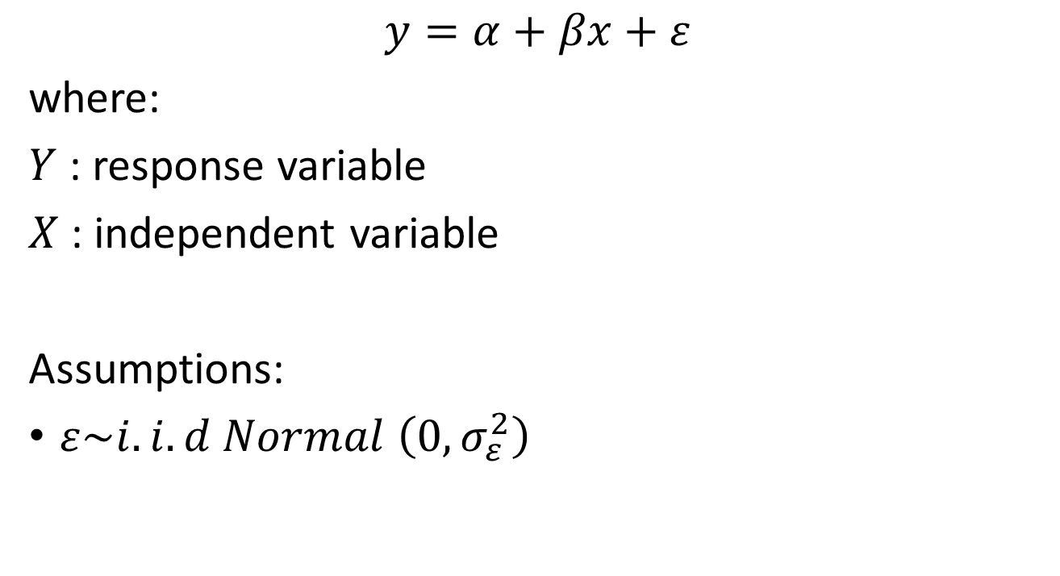
Simple Linear Regression
$$y=α+βx+ε$$
where:
$Y$ : response variable
$X$ : independent variable
Assumptions:
$ε\sim i.i.d Normal \left(0,σ_{ε}^{2}\right)$

Slide 91
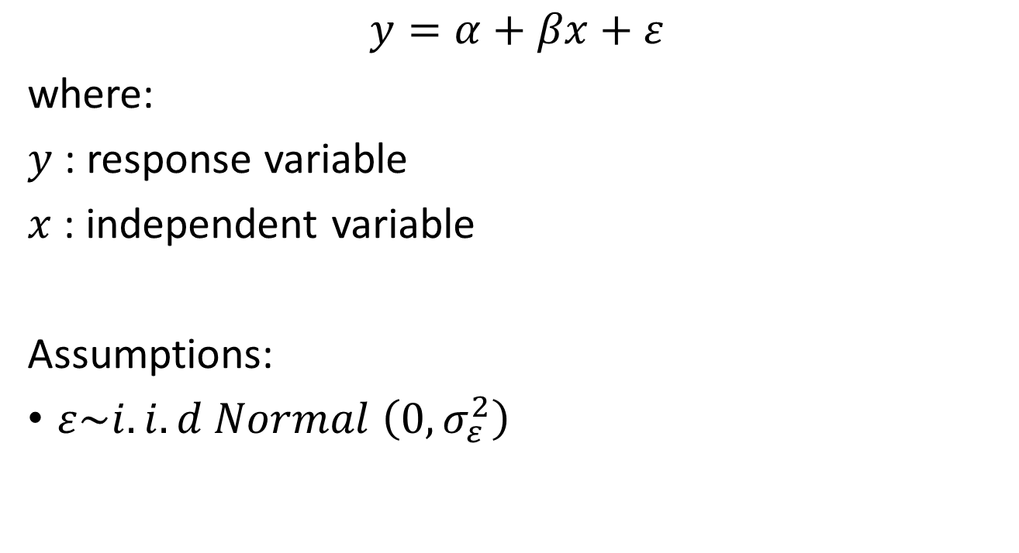
Simple Linear Regression
$$y=α+βx+ε$$
where:
$y$ : response variable
$x$ : independent variable
Assumptions:
$ε\sim i.i.d Normal \left(0,σ_{ε}^{2}\right)$
Continuous variable

Slide 92

What if our response variable is a binary variable?

Slide 93
Illustration
A bank wants to know which debtors are at risk to experience a default on their credit.

Slide 94
Binary Logistics Regression

Slide 95


Binary Response

Slide 96
Binary Response
DEFAULT
NOT DEFAULT

Slide 97
Why can’t we use Linear Regression to model binary responses?
The response (Y) is NOT normally distributed
The variability of Y is NOT constant
Variance of Y depends on the expected value of Y
The model must produce predicted/fitted probabilities that are between 0 and 1
Linear models produce fitted responses that vary from -∞ to ∞

Slide 98
What does logistics regression do?
Model regresi logistik menggunakan peubah penjelas, baik kategorik atau kontinu, untuk memprediksi peluang dari hasil yang spesifik.
Dengan kata lain, regresi logistik dirancang untuk menggambarkan peluang yang terkait dengan nilai-nilai peubah respon.

Slide 99
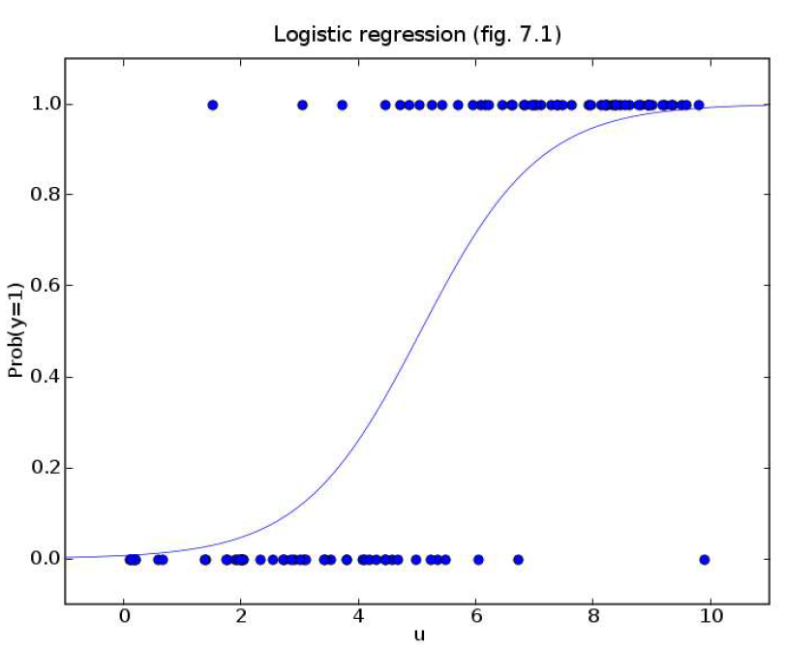

Slide 100
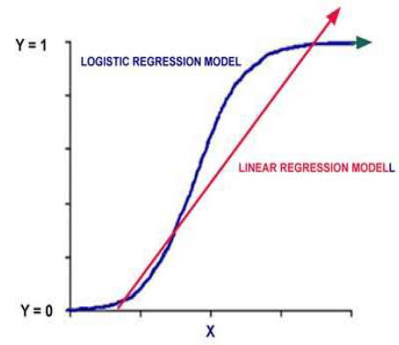
Kurva Regresi Logistik Vs Regresi Linear

Slide 101
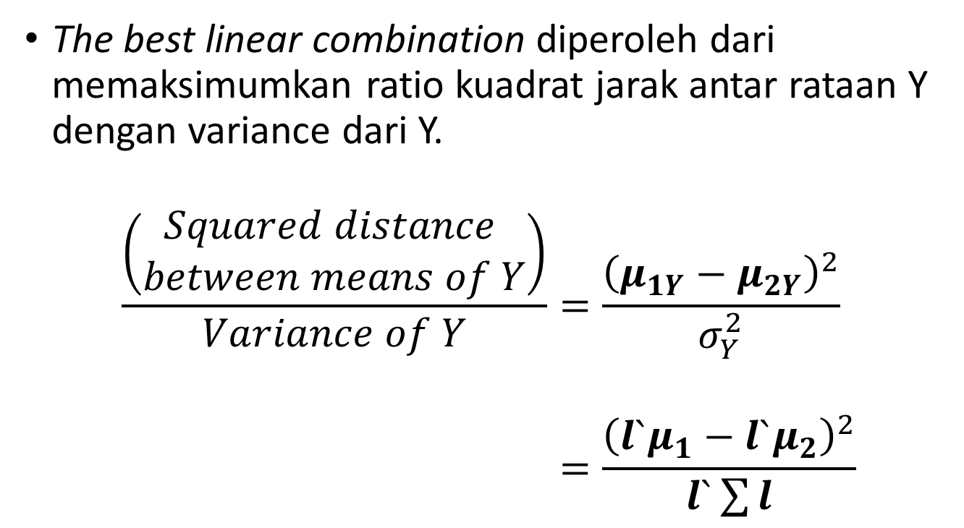
β>0 maka kurva akan naik
β<0 maka kurva akan turun
Jika β= 0 maka nilai berapapun nilai $π\left(x\right)$ konstan
Berapapun nilai X → kurva akan menjadi garis horizontal

Slide 102
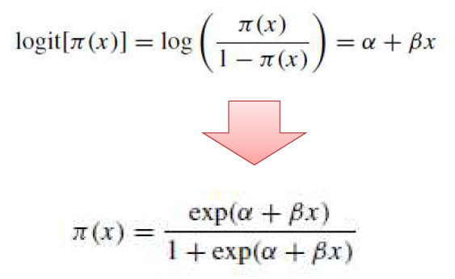
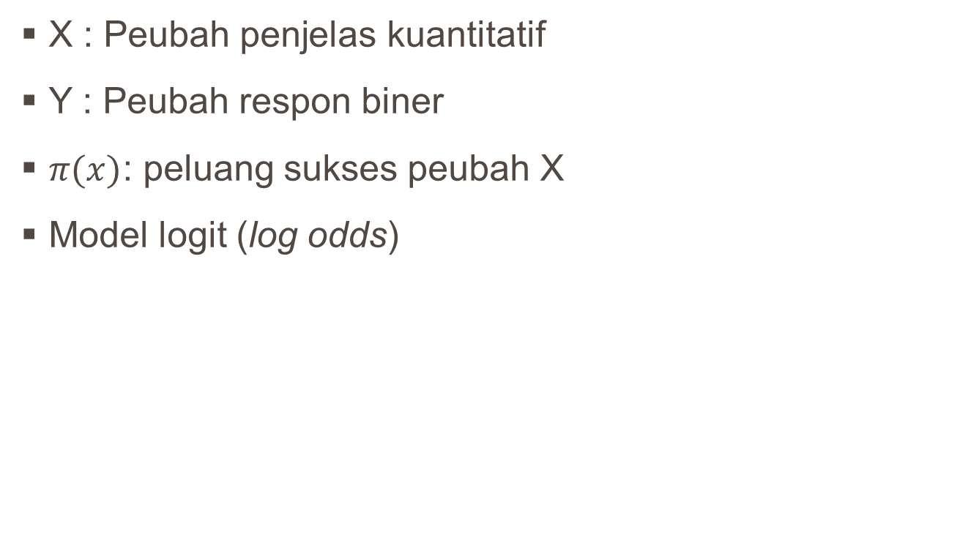
Logistics Regression Model
X : Peubah penjelas kuantitatif
Y : Peubah respon biner
$π(x)$: peluang sukses peubah X
Model logit (log odds)

Slide 103
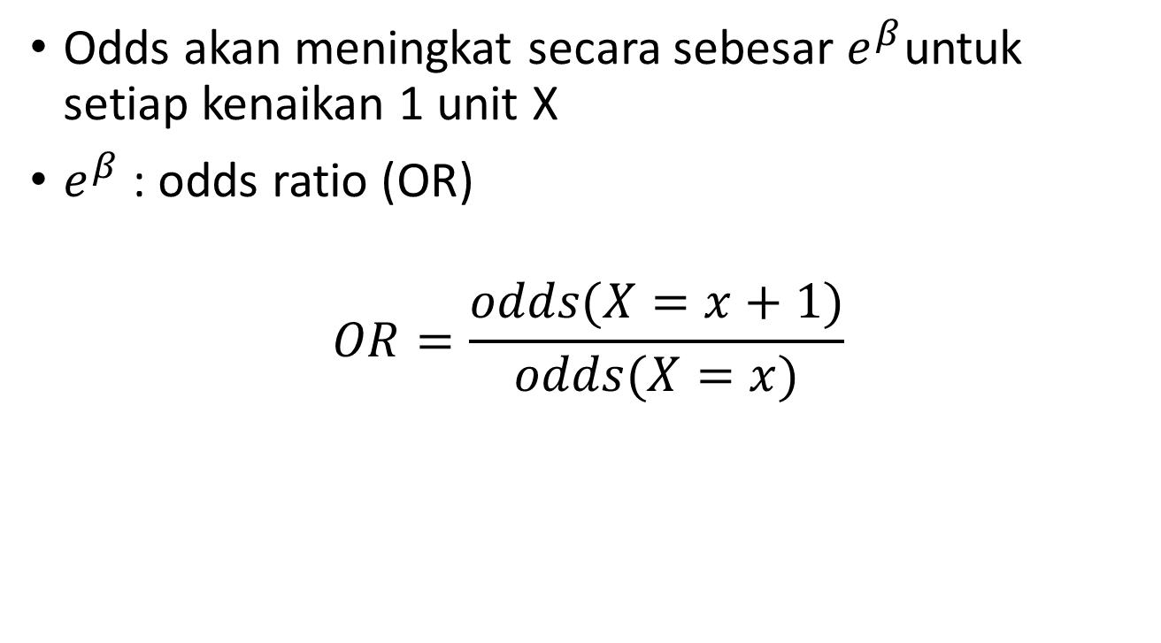

Interpretasi nilai $β$
Odds akan meningkat secara sebesar $e^{β}$untuk setiap kenaikan 1 unit X
$e^{β}$ : odds ratio (OR)
$$OR=\frac{odds(X=x+1)}{odds(X=x)}$$

Slide 104
What Is an Odds Ratio?
An odds ratio indicates how much are likely, with respects to odds, a certain event occurs in one group relative to its occurrence in another group.

Slide 105
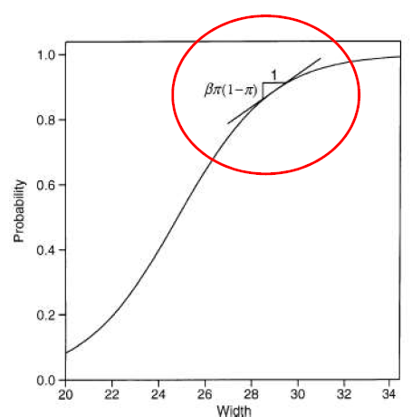
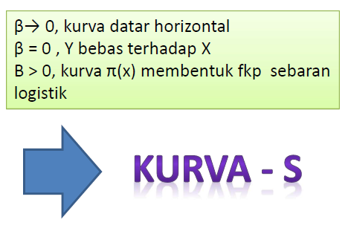
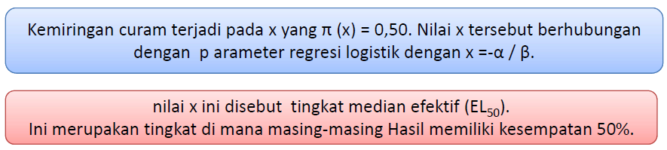
Linear Approximation Interpretations

Slide 106
Illustration
German Credit Data Set
The German Credit Data contains data on 20 variables and the classification whether an applicant is considered a Good or a Bad credit risk for 1000 loan applicants.
A predictive model developed on this data is expected to provide a bank manager guidance for making a decision whether to approve a loan to a prospective applicant based on his/her profiles.

Slide 107
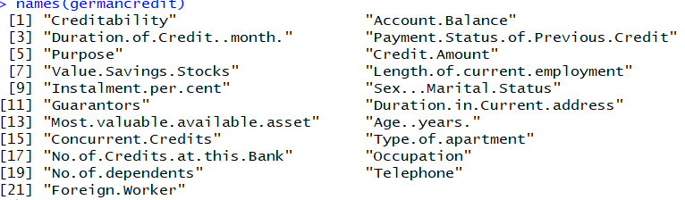
German Credit Data Set
germancredit<- read.csv('https://raw.githubusercontent.com/raoy/Mandiri-Training/master/german_credit.csv', header=T)
names(germancredit)

Slide 108
German Credit Data Set
Account Balance: No account (1), None (No balance) (2), Some Balance (3)
Payment Status: Some Problems (1), Paid Up (2), No Problems (in this bank) (3)
Savings/Stock Value: None, Below 100 DM, [100, 1000] DM, Above 1000 DM
Employment Length: Below 1 year (including unemployed), [1, 4), [4, 7), Above 7
Sex/Marital Status: Male Divorced/Single, Male Married/Widowed, Female
No of Credits at this bank: 1, More than 1
Guarantor: None, Yes
Concurrent Credits: Other Banks or Dept Stores, None
ForeignWorker variable may be dropped from the study
Purpose of Credit: New car, Used car, Home Related, Other

Slide 109
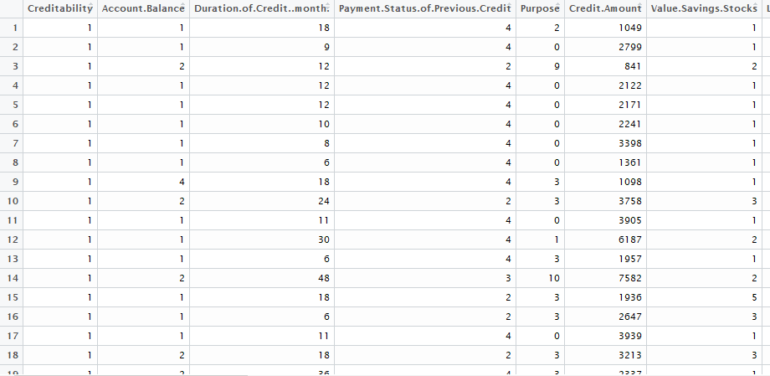
German Credit Data Set

Slide 110
Model Building with 50:50 Cross-validation
set.seed(345)
indexes = sample(1:nrow(German.Credit), size=0.5*nrow(German.Credit)) # Random sample of 50% of row numbers created
Train50 <- German.Credit[indexes,] # Training data contains created indices
Test50 <- German.Credit[-indexes,] # Test data contains the rest
1000 observations are randomly partitioned into two equal sized subsets – Training and Test data. A logistic model is fit to the Training set.

Slide 111
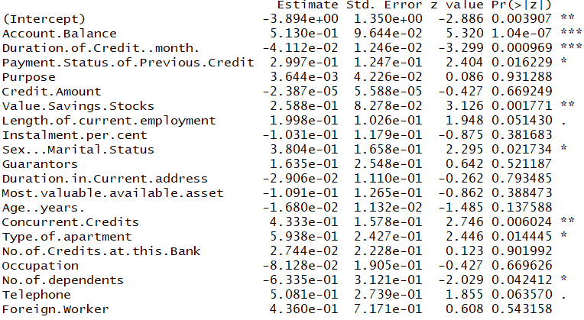
Model Building with 50:50 Cross-validation
LogisticModel50 <- glm(Creditability ~ ., family=binomial, data = Train50)
summary(LogisticModel50)

Slide 112
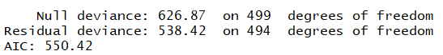
Model Building with 50:50 Cross-validation
LogisticModel50 <- glm(Creditability ~ ., family=binomial, data = Train50)
summary(LogisticModel50)

Slide 113
Removing the nonsignificant variables
LogisticModel50.rev <- glm(Creditability ~ Account.Balance +Duration.of.Credit..month.+ Payment.Status.of.Previous.Credit + Value.Savings.Stocks + Sex...Marital.Status + Type.of.apartment + Concurrent.Credits+No.of.dependents, family=binomial, data = Train50)

Slide 114
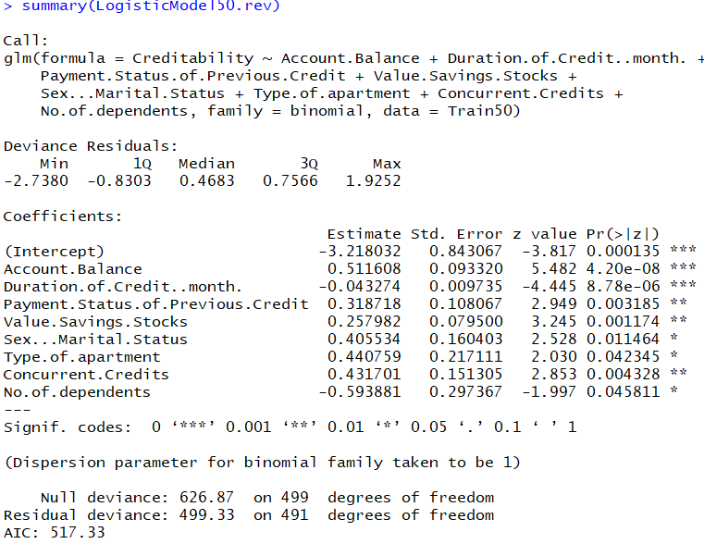
Removing the nonsignificant variables

Slide 115
Confusion Matrix
fit50 <- fitted.values(LogisticModel50.rev)
Threshold50 <- rep(0,500)
for (i in 1:500)
if(fit50[i] >= 0.5) Threshold50[i] <- 1
Library(gmodels)
CrossTable(Train50$Creditability, Threshold50, digits=1, prop.r=F, prop.t=F, prop.chisq=F, chisq=F, data=Train50)

Slide 116
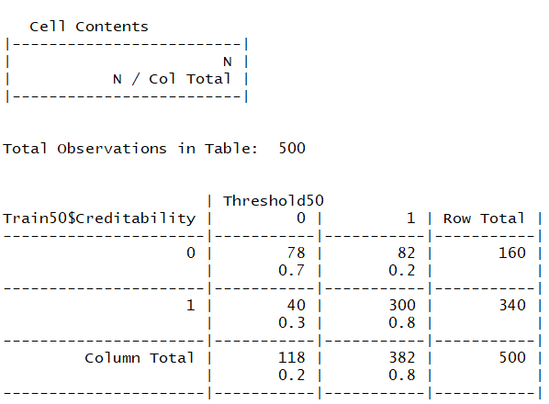
Confusion Matrix

Slide 117
ROC Curve
library(ROCR)
pred<-prediction(predict.glm(LogisticModel50.rev, Test50),Test50$Creditability)
perf <- performance(pred,"tpr","fpr")
plot(perf)

Slide 118
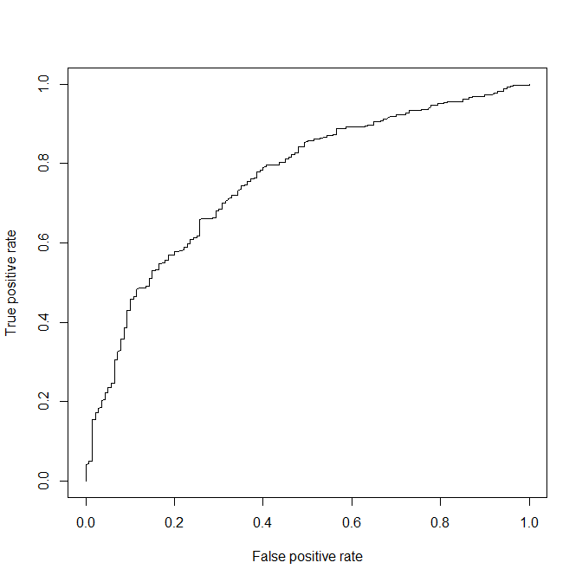
ROC Curve

Slide 119
Ordinal Logistics Regression

Slide 120
Ordinal Logistics Regression Model (OLM)
This is the most common model for ordinal outcomes.
The logit version also called:
the proportional odds model
the cumulative logit model
OLM also known as:
parallel regression model
grouped continuous model

Slide 121
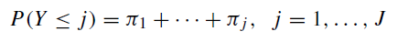
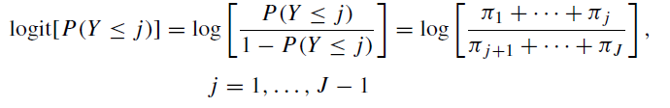
Cumulative Logit Models for Ordinal Responses
A cumulative probability for Y is the probability that Y falls at or belowa particular point.
For outcome category j , the cumulative probability is:
The logits of the cumulative probabilities are

Slide 122
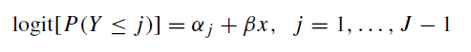
Cumulative Logit Models with Proportional Odds Property
A model for cumulative logit j looks like a binary logistic regression model in which categories 1–j combine to form a single category and categories j + 1 to J form a second category.
For an explanatory variable x, the model

Slide 123
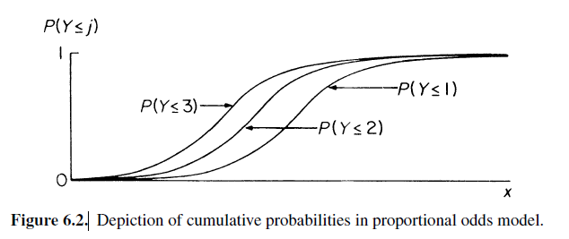
Depiction of Cumulative Probabilities in Proportional Odds Model

Slide 124
Illustration
In this dataset, we are provided variables describing attributes of life insurance applicants.
The task is to predict the "Response" variable for each applicants in the test set.
"Response" is an ordinal measure of risk that has 8 levels.
Response: rank of the risk
Extremely low risk | 1 | 2 | ….. | 7 | 8 | Extremely high risk

Slide 125
Explanatory Variables
Product_Info_1-4 : A set of normalized variables relating to the product applied for
BMI : Normalized BMI of applicant history of the applicant.
InsuredInfo_1-5 : A set of normalized variables providing information about the applicant.
Insurance_History_1-3: A set of normalized variables relating to the insurance history of the applicant.
Family_Hist : Variables relating to the family history of the applicant.
Medical_History_1-6 : A set of normalized variables relating to the medical history of the applicant.
Employment_Info : Variables relating to the employment

Slide 126
Application on R
using vglm() from package VGAM
using rlm() from package rms
using polr() from package MASS
using clm() from package ordinal

Slide 127
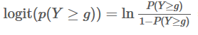
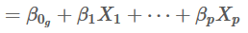
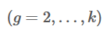
Using vglm function
Model using cumulative logits:

Slide 128
Ordinal Logistic Modeling
ordinaldata<-read.csv("https://raw.githubusercontent.com/raoy/Mandiri-Training/master/training_ordinal.csv",sep=",", header=T)
library(VGAM)
(vglmFit <- vglm(Response ~BMI+Product_Info_2+InsuredInfo_3+Insurance_History_3+Family_Hist+Medical_History_1+Employment_Info, family=propodds, data=ordinaldata))

Slide 129
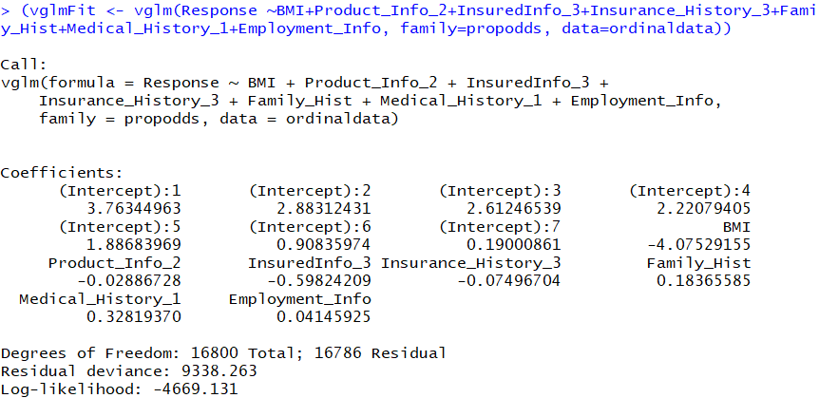
Ordinal Logistic Modeling

Slide 130
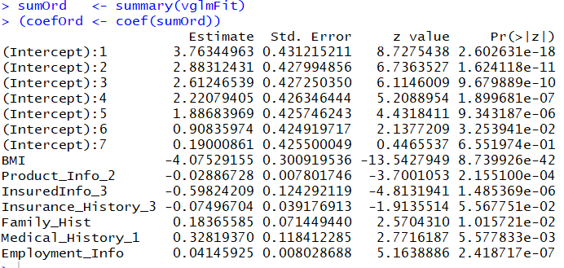
Coefficient tests and overall model test
sumOrd <- summary(vglmFit)
(coefOrd <- coef(sumOrd))

Slide 131
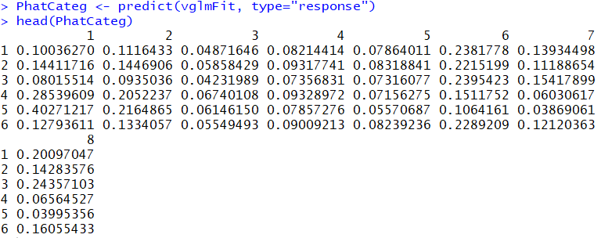
Predict category probabilities
PhatCateg <- predict(vglmFit, type="response")
head(PhatCateg)

Slide 132
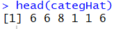
Predicted categories
categHat <- as.numeric(levels(as.factor(ordinaldata$Response))[max.col(PhatCateg)])
head(categHat)

Slide 133
Apply regression model to new data
dfNew<-read.csv("https://raw.githubusercontent.com/raoy/Mandiri-Training/master/test_ordinal.csv",sep=",", header=T)
predOrd<-predict(vglmFit, dfNew, type="response")
categpredOrd <- as.numeric(levels(as.factor(ordinaldata$Response))[max.col(predOrd)])

Slide 134
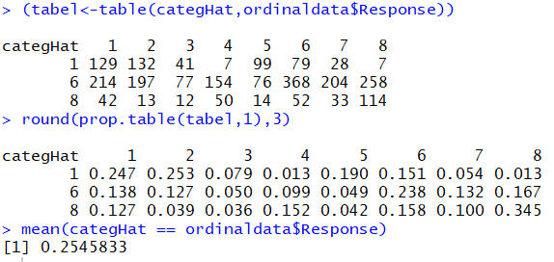
Classification table
(tabel<-table(categHat,ordinaldata$Response))
round(prop.table(tabel,1),3)
mean(categHat == ordinaldata$Response)

Slide 135
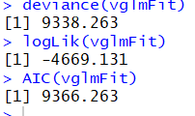
Deviance, log-likelihood and AIC
deviance(vglmFit)
logLik(vglmFit)
AIC(vglmFit)

Slide 136
McFadden, Cox & Snell and Nagelkerke pseudo-R²
vglm0 <- vglm(Response ~ 1, family=propodds, data=ordinaldata)
LLf <- logLik(vglmFit)
LL0 <- logLik(vglm0)
McFadden pseudo-R²
as.vector(1 - (LLf / LL0))
Cox&Snell pseudo-R²
as.vector(1 - exp((2/N) * (LL0 - LLf)))
Nagelkerke pseudo-R²
as.vector((1 - exp((2/N) * (LL0 - LLf))) / (1 - exp(LL0)^(2/N)))

Slide 137
Classification Tree CART
Basic Predictive / Supervised Classification

Slide 138
Classification Tree CART
Also known as:
Classification Tree
Decision Tree
Recursive Partition
Iterative Dichotomiser

Slide 139
Kegunaan
Mengidentifikasi variabel apa yang dapat dijadikan sebagai pembeda antar kelompok
Memprediksi keanggotaan kelompok suatu individu berdasarkan karakteristiknya
Terapannya antara lain:
Marketing: Mengidentifikasi prospective customer (cross-sell, up-sell, new acquisition)
Risk: Credit scoring, menentukan apakah calon penerima kredit akan mampu bayar atau tidak
Customer Relationship: churn analysis, menentukan customer yang berpotensi akan meninggalkan jasa/produk
Health: menentukan tingkat resiko penyakit
dll

Slide 140
Metode lain yang setara kegunaannya
Regresi Logistik
k-Nearest Neighbor
Discriminant Analysis
Support Vector Machine
Bayesian Classifier
dll

Slide 141
Outline
Pengenalan Konsep Entropy dan Information Gain
Pengenalan Algoritma Dasar Pohon Klasifikasi
Menilai Kemampuan Prediksi Pohon Klasifikasi
Pengembangan Lebih Lanjut dari Pohon Klasifikasi

Slide 142
Entropy dan Information Gain

Slide 143
Entropy dan Information Gain
Andaikan sebuah gugus data D berisi individu-individu dengan dua kelas yaitu kelas YES dan NO, dengan proporsi yang YES sebesar p, dan tentusaja (1 – p) lainnya tergolong kelas NO.
Entropi dari gugus data tersebut adalah
E(D) = –p log₂(p) – (1–p) log₂(1–p)
Gugus data yang seluruh amatannya dari kelas YES akan memiliki E(D) = 0
Gugus data yang seluruh amatannya dari kelas NO juga akan memiliki E(D) = 0
Entropi ini adalah ukuran keheterogenan data (impurity)

Slide 144
Entropy dan Information Gain
Very impure group
Less impure
Minimum impurity

Slide 145
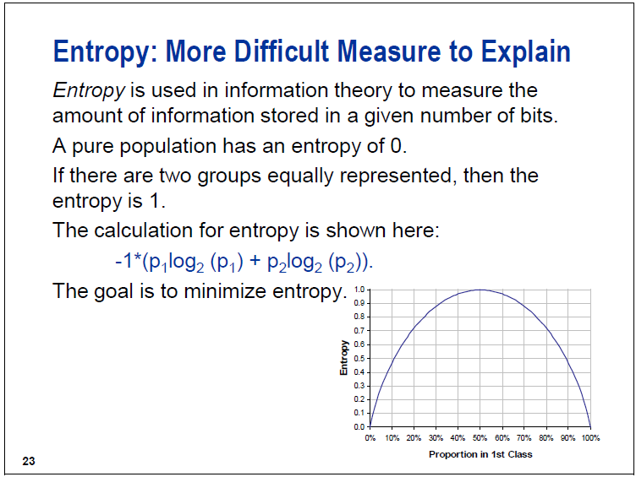
E(D) = –p log₂(p) – (1–p) log₂(1–p)

Slide 146
Entropy dan Information Gain
Andaikan sebuah gugus data D dibagi menjadi beberapa kelompok, misalnya D₁, D₂, …, D_{k} berdasarkan variabel prediktor V
Dari setiap D_{i} bisa dihitung entropinya, yaitu E(D_{i})
Information Gain adalah
Pemisahan yang menghasilkan kelompok-kelompok yang homogen → memiliki information gain yang semakin besar

Slide 147
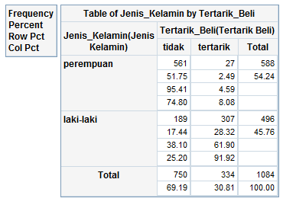
Entropy dan Information Gain
E(TOTAL) = –p log₂(p) – (1–p) log₂(1–p)
E(TOTAL) = –0.3081 log₂(0.3081) – 0.6919 log₂(0.6919)
E(TOTAL) = 0.8910
E(Perempuan) = –p log₂(p) – (1–p) log₂(1–p)
E(Perempuan) = –0.0459 log₂(0.0459) – 0.9541 log₂(0.9541)
E(Perempuan) = 0.2688
E(Laki-Laki) = –p log₂(p) – (1–p) log₂(1–p)
E(Laki-Laki) = –0.6190 log₂(0.6190) – 0.3810 log₂(0.3810)
E(Laki-Laki) = 0.9588
Information Gain dari pemisahan berdasarkan Jenis Kelamin
IG = 0.8910 – ( 588/1084 * 0.2688 + 496/1084 * 0.9588)
IG = 0.8910 – 0.5845
IG = 0.3065

Slide 148
Classification Tree

Slide 149
Ide Dasar
B
16 obs
4
13 obs
Mencari pemisah terbaik antara individu dengan individu
3
2
1
Pemisahan dilakukan untuk masing-masing variabel, bukan kombinasinya.
A
1
2
3
4

Slide 150
Ide Dasar
16 obs
B
13 obs
4
Pemisah yang dicari adalah yang menyebabkan data hasil pemisahannya bersifat homogen kelasnya.
3
2
1
A
1
2
3
4

Slide 151
Ide Dasar
B
A < 2
A ≥ 2
Pemisahan menggunakan garis A = 2, menghasilkan dua kelompok:
Kelompok 1 A < 2
Kelompok 2 A ≥ 2
4
3
2
7 obs
12 obs
1
A
9 obs
1 obs
16 obs
1
2
3
4
13 obs

Slide 152
Ide Dasar
B
A < 2.7
A ≥ 2.7
Pemisahan menggunakan garis A = 2.7, menghasilkan dua kelompok:
Kelompok 1 A < 2.7
Kelompok 2 A ≥ 2.7
4
3
2
11 obs
13 obs
1
5 obs
A
0 obs
16 obs
1
2
3
4
13 obs

Slide 153
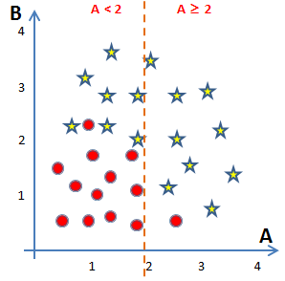
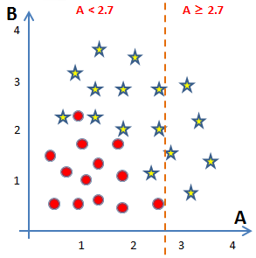
Ide Dasar
16 obs
13 obs
7 obs
9 obs
11 obs
5 obs
12 obs
1 obs
13 obs
0 obs
Mana yang lebih baik?

Slide 154
Ide Dasar
16 obs
13 obs
Entropy = 0.9923
7 obs
9 obs
11 obs
5 obs
12 obs
1 obs
13 obs
0 obs
E = 0.9495

E = 0.4690
E = 0.9950
E = 0
Information Gain = 0.2085
Information Gain = 0.1688

Slide 155
Ide Dasar
◆
A = 2
B
4
3
Lanjutkan mencari pemisahan untuk masing-masing kelompok….
2
1
A
1
2
3
4

Slide 156
Ide Dasar
◆
A = 2
B
4
3
Lanjutkan mencari pemisahan untuk masing-masing kelompok….
❖
B = 1.9
2
1
⬥
B = 0.6
A
1
2
3
4

Slide 157
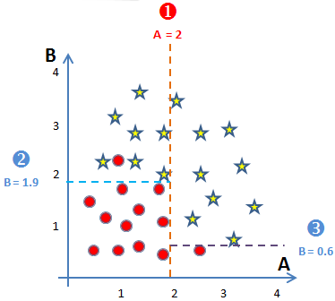
Representasi Hasil Pemisahan
16 obs
13 obs
A < 2
7 obs
9 obs
12 obs
1 obs
B < 1.9
B < 0.6
0 obs
7 obs
0 obs
9 obs
11 obs
1 obs
1 obs
0 obs

Slide 158
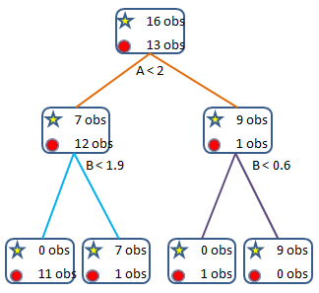
Beberapa Istilah
root
(simpul akar)
Level 0
node
(simpul)
Level 1
depth
leaf
(simpul akhir)
Level 2

Slide 159
Algoritma Dasar Pohon Klasifikasi
Tahap 1:
Mencari pemisahan/penyekatan (splitting) terbaik di setiap variabel
Tahap 2:
Menentukan variabel terbaik untuk penyekatan
Tahap 3:
Melakukan penyekatan berdasarkan hasil dari Tahap 2, dan memeriksa apakah sudah waktunya menghentikan proses
Lakukan tiga tahapan di atas untuk setiap simpul dan hasil sekatannya

Slide 160
Kriteria Penghentian Proses Pemisahan
Simpul berisi amatan yang berasal dari satu kelas variabel respon
Simpul berisi amatan yang seluruh variabel prediktornya identik
Simpul berisi amatan yang kurang dari ukuran simpul minimal yang ditentukan di awal
Kedalaman pohon sudah mencapai kedalaman maksimal

Slide 161
Ilustrasi Sederhana
Gunakan “datatree01.csv”
Variabel respon:
Tertarik_Beli
Variabel Prediktor:
Jenis_Kelamin
Single
Perokok
Tinggal
Usia
Budget

Slide 162
Ilustrasi Sederhana (WPS)
propensity <- read.csv("D:/datatree01.csv", sep=";", header=TRUE)
tertarik <- factor(propensity$Tertarik.Beli., levels = 0:1, labels = c("Tidak", "Tertarik"))
jk <- factor(propensity$Jenis.Kelamin, levels = 0:1, labels = c("Perempuan", "Laki-Laki"))
kota <- factor(propensity$Tinggal.di.Kota, levels = 0:1, labels = c("Tidak", "Ya"))
single <- factor(propensity$Single, levels = 0:1, labels = c("Menikah", "Single"))
merokok <- factor(propensity$Perokok, levels = 0:1, labels = c("Tidak", "Ya"))
budget <- propensity$Budget
usia <-propensity$usia
library(rpart)
model.01 <- rpart(tertarik ~ jk + kota + single + usia + merokok + budget,
method="class", control = rpart.control(minsplit = 100))
model.01

Slide 163
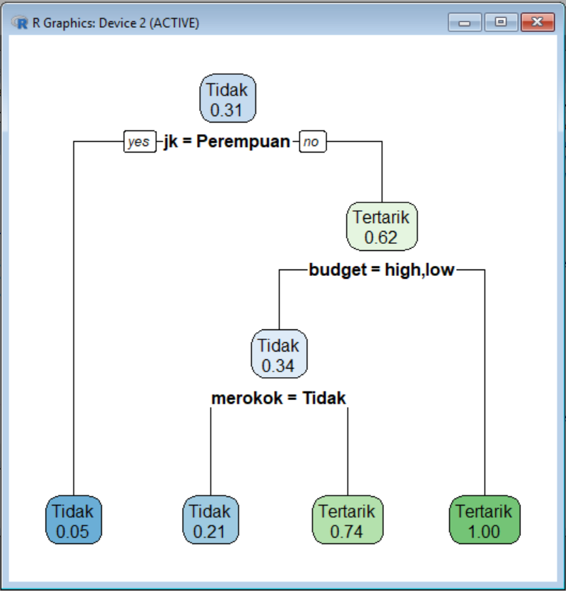
library(rpart.plot)
rpart.plot(model.01, extra=6)

Slide 164
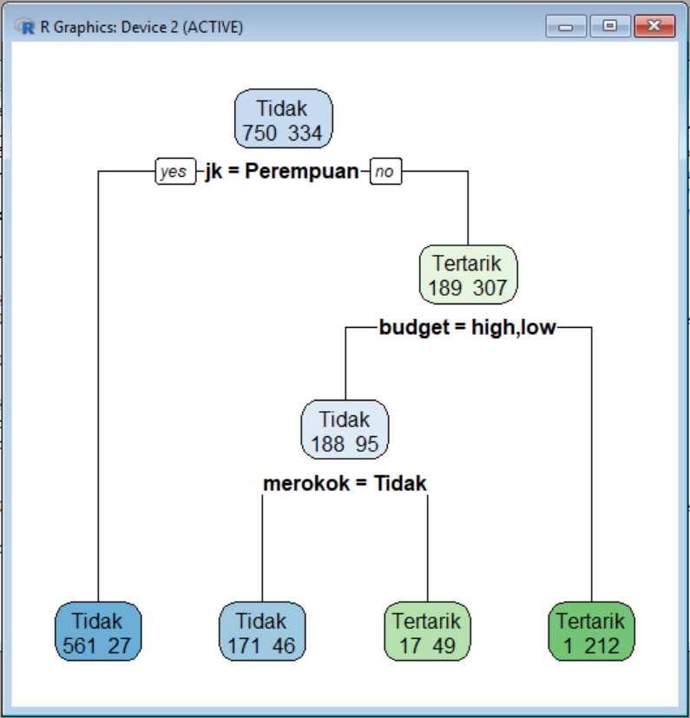
rpart.plot(model.01, extra=1)

Slide 165
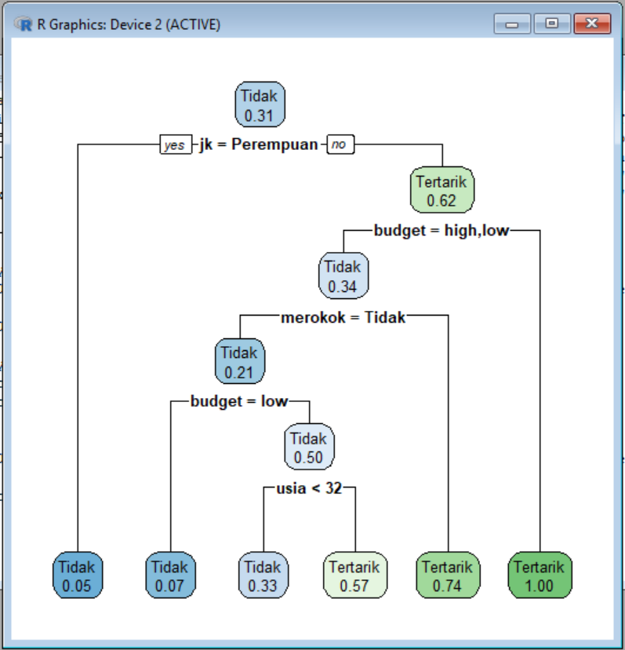
model.02 <- rpart(tertarik ~ jk + kota + single + usia + merokok + budget,
method="class", control = rpart.control(minsplit = 50))
rpart.plot(model.02, extra=6)

Slide 166
Goodness of Fits

Slide 167
Prediksi Variabel Respon
Untuk setiap individu yang diketahui nilai-nilai variabel prediktor yang muncul pada pohon klasifikasi, kita dapat melakukan prediksi kelas variabel respon. Misalnya jika diketahui usia, jenis kelamin, apakah merokok, dan klasifikasi budget dari seseorang, maka kita dapat memprediksi apakah orang tersebut akan tertarik atau tidak.
Bagaimana caranya? Gunakan alur pencabangan yang ada pada pohon klasifikasi sampai berhenti di simpul akhir. Berdasarkan simpul akhir itulah kita prediksi dia masuk ke kategori apa.

Slide 168
Prediksi Variabel Respon
Misal
Jenis Kelamin = Laki-Laki
Budget = Low
Merokok = Ya
Usia 25 tahun
Tinggal di Kota
Single
Probability TERTARIK = 0.74

Slide 169
Prediksi Variabel Respon
Misal
Jenis Kelamin = Laki-Laki
Budget high
Tidak Merokok
Usia 25 tahun
Tinggal di Kota
Single
Probability TERTARIK = 0.74

Slide 170
SPLIT DATA
#split data training dan testing
data.all<- data.frame(jk, kota, single, usia, merokok, budget, tertarik)
index<-createDataPartition(y=data.all$tertarik,p=0.7,list=F)
training<-data.all[index,]
testing<-data.all[-index,]

Slide 171

Prediksi Variabel Respon
prob.prediksi.train <- predict(model.02, newdata=training)
head(prob.prediksi.02)

Slide 172
Prediksi Variabel Respon
Andaikan digunakan batasan 0.5 untuk mengelompokkan ketertarikan, sehingga kalau
Prob(Tertarik) > 0.5 → Tertarik
Prob(Tertarik) ≤ 0.5 → tidak
Maka kita akan dapatkan
Tidak Tertarik Prediksi
1 0.925170068 0.07482993 → Tidak
2 0.954081633 0.04591837 → Tidak
3 0.954081633 0.04591837 → Tidak
4 0.954081633 0.04591837 → Tidak
5 0.004694836 0.99530516 → Tertarik
6 0.954081633 0.04591837 → Tidak
7 0.004694836 0.99530516 → Tertarik
8 0.925170068 0.07482993 → Tidak
9 0.954081633 0.04591837 → Tidak
10 0.428571429 0.57142857 → Tertarik

Slide 173
Prediksi Variabel Respon
Perbandingan antara respon yang sebenarnya dengan dugaan
Tertarik_beli dugaan
1 Tidak Tidak
2 Tidak Tidak
3 Tidak Tidak
4 Tidak Tidak
5 Tertarik Tertarik
6 Tidak Tidak
7 Tertarik Tertarik
8 Tidak Tidak
9 Tidak Tidak
10 Tidak Tertarik → salah prediksi

Slide 174
Prediksi Variabel Respon
Perbandingan antara respon yang sebenarnya dengan dugaan
Tertarik_beli dugaan
1 Tidak Tidak
2 Tidak Tidak
3 Tidak Tidak
4 Tidak Tidak
5 Tertarik Tertarik
6 Tidak Tidak
7 Tertarik Tertarik
8 Tidak Tidak
9 Tidak Tidak
10 Tidak Tertarik → salah prediksi

Slide 175
Classification Table
Predicted Class
0
1
True
Negative
False
Positive
Actual
Negative
0
Actual Class
False
Negative
True
Positive
Actual
Positive
1
Predicted
Negative
Predicted
Positive
Proporsinya harus tinggi
Notes:
Ingat bahwa dengan model yang kita peroleh, kita dapat memasukkan data nilai-nilai variabel penjelas yang kita miliki untuk memperoleh dugaan peluang masing-masing individu. Dengan prediksi peluang tersebut, kita dapat mengelompokkan apakah dia diprediksi YES (bernilai 1) atau NO (bernilai 0). Selanjutnya bisa kita bandingkan dengan nilai yang sebenarnya (aktual)
Teknik sederhana yang dapat dilakukan untuk menentukan tingkat kebaikan pendugaan/prediksi dari model yang kita miliki adalah menggunakan tabel klasifikasi. Tabel ini merupakan tabel frekuensi dua arah antara nilai kategori aktual data dengan kategori prediksinya. Pada gambar tabel di slide, tentu kita menginginkan model yang memiliki proporsi yang benar sangat tinggi.
Jika ada dua model, kita dapat menghitung tingkat ketepatan masing-masing model.
Kembali ke tabel klasifikasi dan perhatikan definisi berikut:
TRUE POSITIVE adalah banyaknya individu dalam kategori YES (1) yang diprediksi dengan tepat.
TRUE NEGATIVE adalah banyaknya individu dalam kategori NO (0) yang diprediksi dengan tepat.
FALSE POSITIVE adalah banyaknya individu dalam kategori NO (0) yang diprediksi dengan salah.
FALSE NEGATIVE adalah banyaknya individu dalam kategori YES (1) yang diprediksi dengan salah.
N₁ adalah banyaknya individu yang memiliki kategori YES (1)
N₂ adalah banyaknya individu yang memiliki kategori NO (0)

Slide 176
Accuracy (Correct Rate)
Predicted Class
0
1
True
Negative
False
Positive
Actual
Negative (N₂)
0
Actual Class
False
Negative
True
Positive
Actual
Positive (N₁)
1
Predicted
Negative
Predicted
Positive
Correct Rate = (True Positive + True Negative) / N

Slide 177
Sensitivity
Predicted Class
0
1
0
Actual Class
True
Positive
Actual
Positive
1
Predicted
Positive

Slide 178
Sensitivity
SENSITIVITY adalah TRUE POSITIVE dibagi dengan N₁
Jika cutoff nilai prediksi peluang yang digunakan kecil, maka individu cenderung akan diprediksi memiliki kategori 1 (YES). Sehingga pada saat nilai cutoff kecil, maka sensitivity ini akan besar (mendekati 100%). Secara umum nilai sensitivity ini akan menurun jika nilai cutoff ditingkatkan. Namun secara ideal kita menginginkan untuk berbagai nilai cutoff, model memiliki sensitivity yang tinggi.

Slide 179
Specificity
Predicted Class
0
1
True
Negative
Actual
Negative
0
Actual Class
1
Predicted
Negative

Slide 180
Specificity
SPECIFICITY adalah TRUE NEGATIVE dibagi dengan N₂
Tentu saja 1 – Specificity adalah 1 dikurangi nilai specificity-nya, atau diperoleh dari FALSE POSITIVE dibagi dengan N₂.
Jika cutoff nilai prediksi peluang yang digunakan kecil, maka individu cenderung akan diprediksi memiliki kategori 1 (YES). Sehingga pada saat nilai cutoff kecil, maka (1 – specificity) ini akan besar (mendekati 100%). Secara umum nilai (1 – specificity) ini akan menurun jika nilai cutoff ditingkatkan. Namun secara ideal kita menginginkan untuk berbagai nilai cutoff, model memiliki (1 – specificity) yang rendah.

Slide 181

prediksi.train <- factor(ifelse(prob.prediksi.train[,2] > 0.5, 1, 0),
levels = 0:1, labels = c("Tidak", "Tertarik"))
library(caret)
confusionMatrix(prediksi.train, training$tertarik)

Slide 182

Goodness of Classification Tree
Andaikan batas peluangnya diganti dari 0.5 menjadi 0.6
prediksi.train <- factor(ifelse(prob.prediksi.train[,2] > 0.6, 1, 0),
levels = 0:1, labels = c("Tidak", "Tertarik"))
library(caret)
confusionMatrix(prediksi.train, training$tertarik)

Slide 183

Goodness of Classification Tree
Andaikan batas peluangnya diganti dari 0.5 menjadi 0.3
prediksi.train <- factor(ifelse(prob.prediksi.train[,2] > 0.3, 1, 0),
levels = 0:1, labels = c("Tidak", "Tertarik"))
library(caret)
confusionMatrix(prediksi.train, training$tertarik)

Slide 184
Goodness of Classification Tree
Cut-Off | Accuracy | Sensitivity | Specificity
0.3 | 91.61% | 92.93% | 88.62%
0.5 | 92.25% | 94.80% | 86.53%
0.6 | 91.61% | 97.60% | 78.14%

Slide 185
ROC Curve
An ideal ROC curve is a vertical line from the origin to a sensitivity of 1, and then a horizontal line along sensitivity of 1 for all level of (1 – specificity)
ROC curve is usually used to compare competing model
A numerical measure of how close the ROC curve match the ideal curve is computed by comparing the area under the curve to 1. It turns out the area is equal to the c statistic.

Slide 186
ROC Curve
1.0
0.5
Higher ← Cutoff → Lower
Sensitivity
0.0
0.0
0.5
1.0
1 — Specificity

Slide 187

ROC Curve
library(ROCR)
pred <- prediction(prob.prediksi.train[,1], training$tertarik)
roc <- performance(pred, measure="tpr", x.measure="fpr")
auc <- performance(pred, 'auc')
AUC <- auc@y.values[[1]]
plot(roc, col="orange", lwd=2)
lines(x=c(0, 1), y=c(0, 1), col="red", lwd=2)
text(0.6, 0.2, paste0("AUC = ", round(AUC,3)) )

Slide 188
Data Testing
prob.prediksi.test<-predict(model.02, newdata=testing)
prediksi.test<-factor(ifelse(prop.prediksi.test[,2]>0.5,1,0),levels = 0:1,
labels=c("Tidak","Tertarik"))
confusionMatrix(prediksi.test, test$tertarik)

Slide 189
Kriteria Splitting Lain

Slide 190

Ilustrasi lain terkait dengan Gini, Information Gain, dan Chi-Sq

Slide 191

Ilustrasi lain terkait dengan Gini, Information Gain, dan Chi-Sq

Slide 192

Ilustrasi lain terkait dengan Gini, Information Gain, dan Chi-Sq

Slide 193

Ilustrasi lain terkait dengan Gini, Information Gain, dan Chi-Sq

Slide 194

Ilustrasi lain terkait dengan Gini, Information Gain, dan Chi-Sq

Slide 195
Ilustrasi lain terkait dengan Gini, Information Gain, dan Chi-Sq

Slide 196

Ilustrasi lain terkait dengan Gini, Information Gain, dan Chi-Sq

Slide 197

Ilustrasi lain terkait dengan Gini, Information Gain, dan Chi-Sq

Slide 198

Ilustrasi lain terkait dengan Gini, Information Gain, dan Chi-Sq

Slide 199

Ilustrasi lain terkait dengan Gini, Information Gain, dan Chi-Sq

Slide 200

Ilustrasi lain terkait dengan Gini, Information Gain, dan Chi-Sq

Slide 201

Ilustrasi lain terkait dengan Gini, Information Gain, dan Chi-Sq

Slide 202
Random Forest
Ensemble Model

Slide 203
Definition
Random forest merupakan salah satu bentuk teknik klasifikasi ensemble yang tersusun atas banyak pohon klasifikasi dan kelas prediksi merupakan modus (suara terbanyak) dari kelas prediksi yang dihasilkan oleh masing-masing pohon
Istilah ini berasal dari random decision forests yang diusulkan pertama kali oleh Tin Kam Ho dari Bell Labs pada tahun 1995.
Metode ini merupakan gabungan dari ide Breiman tentang bagging dan seleksi variabel secara acak.

Slide 204
Review tentang Classification Tree atau Decision Trees
Pohon klasifikasi merupakan teknik klasifikasi tunggal yang digabungkan dalam metode random forest.
Salah satu algoritma yang banyak digunakan adalah CART… classification and regression tree.
CART … greedy, top-down binary, recursive partitioning, membagi-bagi ruang data menjadi gugus-gugus saling lepas berbentuk rectangular
Gugus-gugus tersebut dibentuk sedemikian rupa sehingga bersifat homogen kelas variabel responnya
Prediksi didasarkan pada kelas terbanyak pada simpul akhir

Slide 205


Review tentang Classification Tree atau Decision Trees
Ilustrasi data
Ilustrasi hasil

Slide 206
Algoritma umum Random Forest
Setiap pohon dibentuk dengan menggunakan prosedur berikut:
Andaikan banyaknya observasi pada data training adalah N dan banyaknya variabel prediktor adalah M.
Tentukan besaran m < M, yaitu banyaknya variabel yang dievaluasi dalam setiap pembentukan sekatan (split) pada pembuatan pohon
Lakukan pengambilan sampel secara bootstrap (sampling with replacement) sebanyak n dari N buah observasi. Observasi sisanya yang tidak terpilih akan digunakan untuk menduga tingkat kesalahan.
Untuk setiap simpul, pilih secara acak m variabel untuk digunakan menentukan sekatan terbaik.
Setiap pohon dibentuk tanpa ada proses pemangkasan.
Prediksi terhadap amatan baru dilakukan pada setiap pohon. Selanjutnya proses majority vote dilakukan untuk menghasilkan prediksi dari random forest.

Slide 207

Flow chart dari algoritma

Slide 208
Random Forest – practical consideration
Berapa banyak pohon?
Berapa banyak variabel yang dipilih secara acak?

Slide 209
Random forest classifier
Random forest classifier, an extension to bagging which uses de-correlated trees.

Slide 210
Random Forest Classifier
Training Data
M features
N examples
Notes:
As the classifier of choice we adopt Random Forest Classifier, due to its robustness to heterogenous and noisy feature.
Random Forest is an ensembe classifier. Briefly, given N data and M features, bootsrap samples are created from the traning data

Slide 211
Random Forest Classifier
Create bootstrap samples
from the training data
M features
N examples
....…

Slide 212

Random Forest Classifier
Construct a decision tree
M features
N examples
....…
Notes:
From eachd descision tree .. In spliting the nodes, the Gini Gain is employed

Slide 213

Random Forest Classifier
At each node in choosing the split feature
choose only among m<M features
M features
N examples
....…
Notes:
Different from the regular decision trees in random forest, when the splitting feature is chosen from only a subset of allf eatures.
The robostness of the classifier arises from
bootsraping of the training data and the random selection of features, the the random choose of features.

Slide 214


Random Forest Classifier
Create decision tree
from each bootstrap sample
M features
N examples
....…
....…

Slide 215
Random Forest Classifier
Create decision tree
from each bootstrap sample
M features
N examples
Take he majority vote
....…
....…

Slide 216


Slide 217
bankloan <- read.csv("D:/bankloan.csv", header=TRUE)
head(bankloan)
#set.seed(20)
acak <- sample(1:nrow(bankloan), 450, replace=FALSE)
bankloan.training <- bankloan[acak,]
bankloan.testing <- bankloan[-acak,]
library(rpart)
model.pohon <- rpart(as.factor(default) ~ age + ed + employ + address
+ income + debtinc + creddebt + othdebt,
data=bankloan.training)
prob.prediksi <- predict(model.pohon, bankloan.testing)
prediksi <- ifelse(prob.prediksi[,2] > 0.5, 1, 0)
tabel <- table(bankloan.testing$default, prediksi)
akurasi <- (tabel[1,1] + tabel[2,2])/sum(tabel) * 100
akurasi

Slide 218
library(randomForest)
#set.seed(100)
model.forest <- randomForest(as.factor(default) ~ age + ed + employ + address
+ income + debtinc + creddebt + othdebt,
data=bankloan.training, importance=TRUE, ntree=2000, mtry=3)
prediksi.rf <- predict(model.forest, bankloan.testing)
tabel.rf <- table(bankloan.testing$default, prediksi.rf)
akurasi.rf <- (tabel.rf[1,1] + tabel.rf[2,2])/sum(tabel.rf) * 100
akurasi.rf
#bisa gunakan confusionMatrix ukt menampilkan akurasi dll
importance(model.forest)
varImpPlot(model.forest)
#getTree(model.forest, labelVar=TRUE, k=2)

Slide 219

Semakin ke kanan semakin penting variable tersebut

Slide 220
Perbandingan Akurasi Pohon Tunggal dan Random Forest
for(i in 1:100){
acak <- sample(1:nrow(bankloan), 450, replace=FALSE)
bankloan.training <- bankloan[acak,]
bankloan.testing <- bankloan[-acak,]
model.pohon <- rpart(as.factor(default) ~ age + ed + employ + address
+ income + debtinc + creddebt + othdebt,
data=bankloan.training)
prob.prediksi <- predict(model.pohon, bankloan.testing)
prediksi <- ifelse(prob.prediksi[,2] > 0.5, 1, 0)
tabel <- table(bankloan.testing$default, prediksi)
akurasi[i] <- (tabel[1,1] + tabel[2,2])/sum(tabel) * 100
model.forest <- randomForest(as.factor(default) ~ age + ed + employ + address
+ income + debtinc + creddebt + othdebt,
data=bankloan.training, importance=TRUE, ntree=2000, mtry=3)
prediksi.rf <- predict(model.forest, bankloan.testing)
tabel.rf <- table(bankloan.testing$default, prediksi.rf)
akurasi.rf[i] <- (tabel.rf[1,1] + tabel.rf[2,2])/sum(tabel.rf) * 100
}
boxplot(cbind(akurasi, akurasi.rf))
plot(akurasi, akurasi.rf)
points(akurasi, akurasi, type="l")

Slide 221


Perbandingan Akurasi Pohon Tunggal dan Random Forest

Slide 222
Menggunakan confusionMatrix
for(i in 1:100){
acak <- sample(1:nrow(bankloan), 450, replace=FALSE)
bankloan.training <- bankloan[acak,]
bankloan.testing <- bankloan[-acak,]
model.pohon <- rpart(as.factor(default) ~ age + ed + employ + address
+ income + debtinc + creddebt + othdebt,
data=bankloan.training)
prob.prediksi <- predict(model.pohon, bankloan.testing)
prediksi <- ifelse(prob.prediksi[,2] > 0.5, 1, 0)
confusi<-confusionMatrix(prediksi, as.factor(bankloan.testing$default))
overall<-data.frame(confusi$overall)
akurasi[i]<-overall[1,]*100
model.forest <- randomForest(as.factor(default) ~ age + ed + employ + address
+ income + debtinc + creddebt + othdebt,
data=bankloan.training, importance=TRUE, ntree=2000, mtry=3)
prediksi.rf <- predict(model.forest, bankloan.testing)
confusi.rf<-confusionMatrix(prediksi.rf, as.factor(bankloan.testing$default))
overall.rf<-data.frame(confuse.rf$overall)
akurasi.rf[i]<-overall.rf[1,]*100
}
boxplot(cbind(akurasi, akurasi.rf))
plot(akurasi, akurasi.rf)
points(akurasi, akurasi, type="l")

Slide 223
Features and Advantages
The advantages of random forest are:
It is one of the most accurate learning algorithms available. For many data sets, it produces a highly accurate classifier.
It runs efficiently on large databases.
It can handle thousands of input variables without variable deletion.
It gives estimates of what variables are important in the classification.

Slide 224
Disadvantages
Random forests have been observed to overfit for some datasets with noisy classification/regression tasks.
For data including categorical variables with different number of levels, random forests are biased in favor of those attributes with more levels. Therefore, the variable importance scores from random forest are not reliable for this type of data.

Slide 225
RM - Additional information
Estimating the test error:
While growing forest, estimate test error from training samples
For each tree grown, 33-36% of samples are not selected in bootstrap, called out of bootstrap (OOB) samples
Using OOB samples as input to the corresponding tree, predictions are made as if they were novel test samples
Through book-keeping, majority vote (classification), average (regression) is computed for all OOB samples from all trees.
Such estimated test error is very accurate in practice, with reasonable N

Slide 226
Conclusions & summary:
Fast fast fast!
RF is fast to build. Even faster to predict!
Practically speaking, not requiring cross-validation alone for model selection significantly speeds training by 10x-100x or more.
Fully parallelizable … to go even faster!
Provide information for predictor selection from large number of candidates
Ability to handle data without preprocessing
data does not need to be rescaled, transformed, or modified
resistant to outliers
automatic handling of missing values

Slide 227
TERIMA KASIH

